Slide 1

Sales Funnel
Performance
Review
Bryce Smith
Data Analyst

Slide 2
Questions to Answer
Where are leads dropping out of the funnel most often?
Which lead sources generate the highest conversion rates?
How do sales reps or regions compare in win rates and cycle time?
Are any stages taking longer than expected?

Slide 3
Executive Summary
Biggest leak: Proposal → Won (-63 %)
Website wins ≈10 % (2× others)
Deals > 60 days seldom win
$ Impact: +90 wins/Q if leak halved

Slide 4
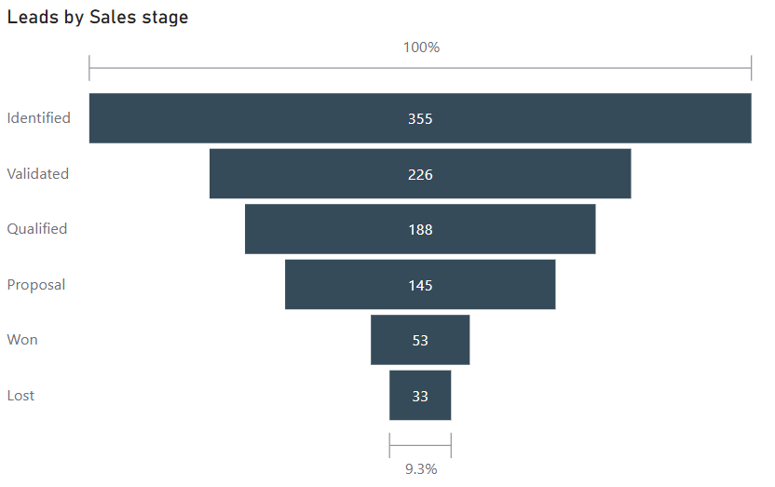
Leak Point:
Proposal → Won
63 % of proposals never close.

Slide 5
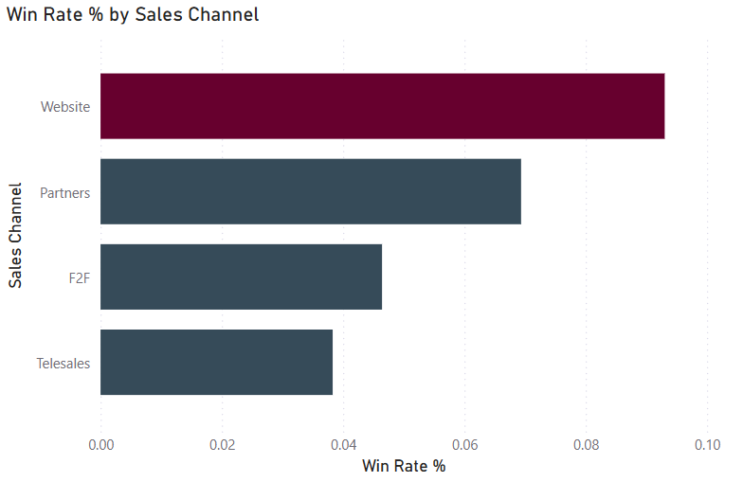
Channel Conversion Rates
Website 10 %
Partner 6 %
F2F 4 %
Telesales 3 %

Slide 6
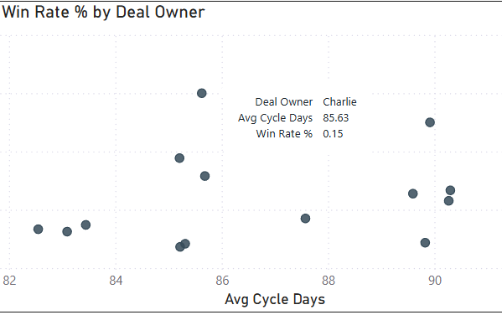
Rep Speed vs. Success
Star rep (85 d / 15 %)
vs.
two coaching clusters

Slide 7
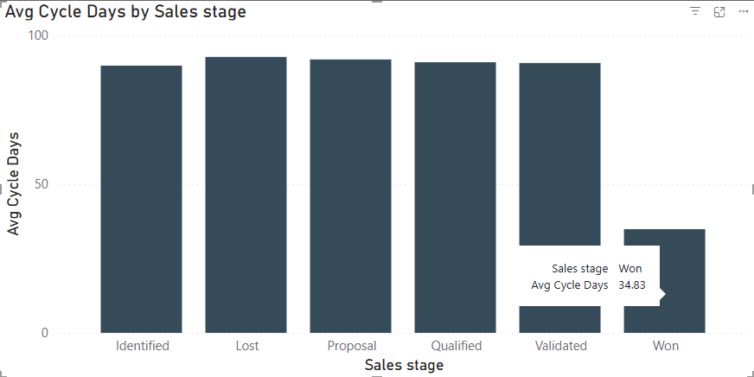
Stage Ageing Snapshot
Won ≈ 38 d
Middle stages ≈ 95 d
Lost ≈ 95 d

Slide 8
Action Plan
Late-stage enablement (QA checklist, pricing guard-rails, exec sponsor)
Channel re-allocation (+30 % Website, nurture Partners, pause low-ROI Telesales)
Ageing alerts (>60 d inactivity)
Rep coaching clinics

Slide 9
Expected Impact
+≈60 wins/Q
Win-rate ↑ to 10 % by Q1 ’26
Timeline bar: Jul ’25 → Sep ’25 → Q4 ’25 checkpoints

Slide 10
Limitations & Appendix Links
Limitations
Links
GitHub here https://github.com/thebryce15/sales-funnel-performance
Single-quarter view
Manual timestamps
Missing
“Unknown” source

